Slide 1

Classification of Histopathological Breast cancer images using Deep Learning
Rishab Kumar
1701EE39
Under the guidance of Dr. M H Kolekar

Slide 2
Introduction
Histopathological images
Mammogram images
Extracted feature based data
Ultrasounds
MRI images
Certain types of breast cancer images
Histopathological images from ICIAR2018 dataset

Slide 3
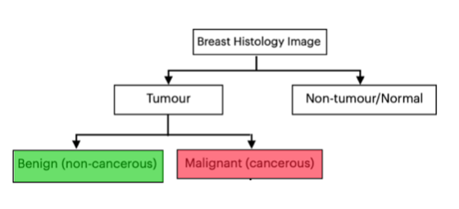
Classification of breast histology images

Slide 4
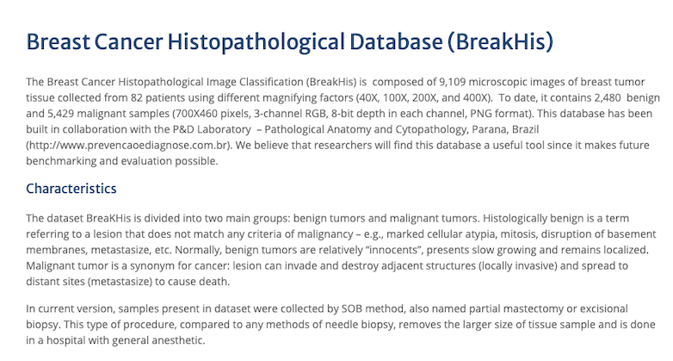
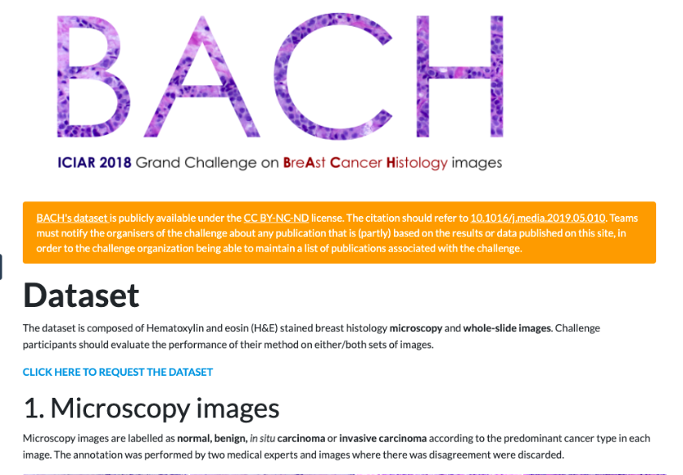
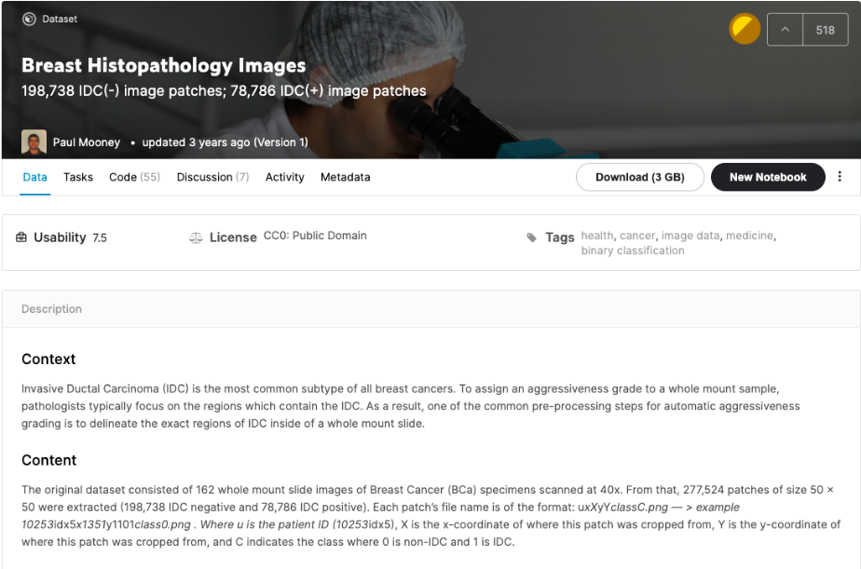
Datasets
Three standard datasets were chosen for training and testing purposes
Breakhis Dataset - 7,909 images
ICIAR2018 Dataset - 400 images
Kaggle Breast Histology Images Dataset - 277,524 images
Breakhis ICIAR2018 Kaggle BHI

Slide 5
Methodology
Combining the features extracted from 5 best performing classification architectures
Chance that an important feature will be missed is very less if we are using 5 independent classification architectures in concatenation
DenseNet201: consists of 201 layers
ResNet152: consists of 152 layers
VGG19: consists of 19 layers
Xception: consists of 71 layers
Inception_v3: consists of 48 layers

Slide 6
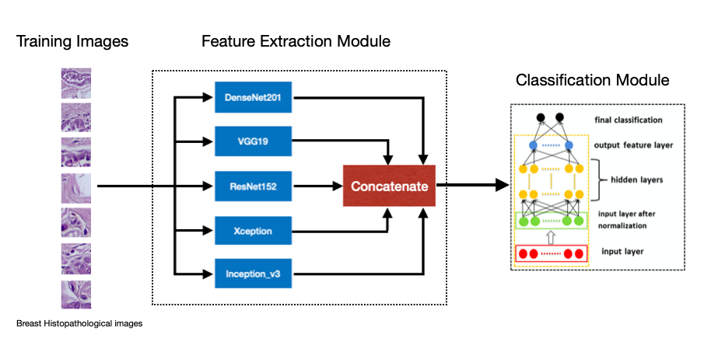
Model flowchart

Slide 7
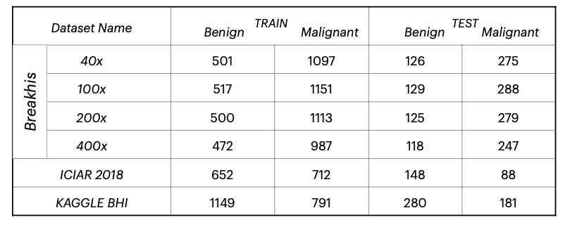
Training
80% training
20% testing
Batch size : 16
Epochs: 100

Slide 8
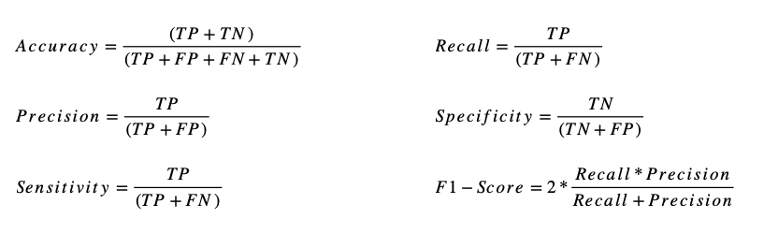
Performance measures
Positive is taken as MALIGNANT and negative is taken as BENIGN

Slide 9
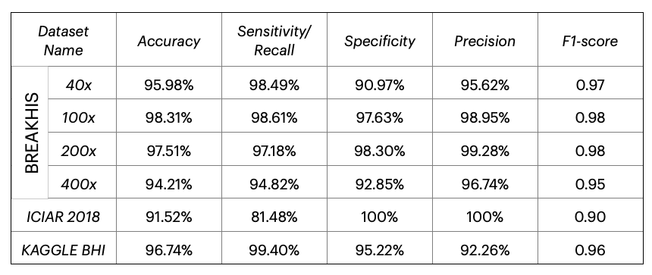
RESULT

Slide 10
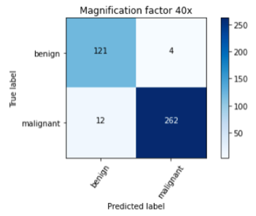
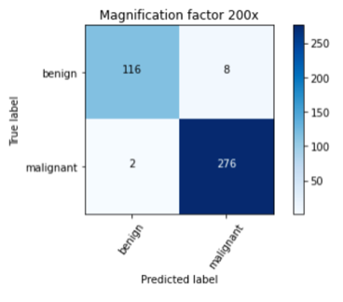
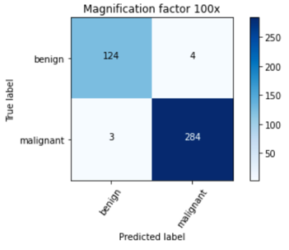
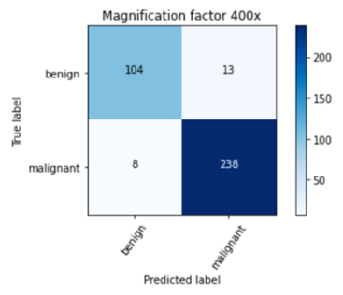
RESULT
Breakhis Dataset

Slide 11
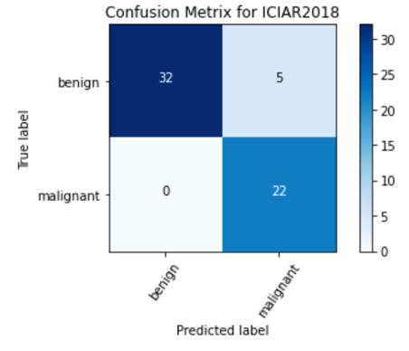
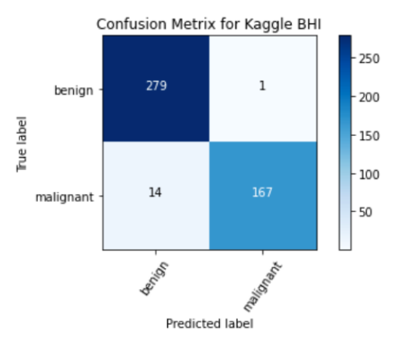
RESULT
ICIAR2018
Kaggle BHI

Slide 12
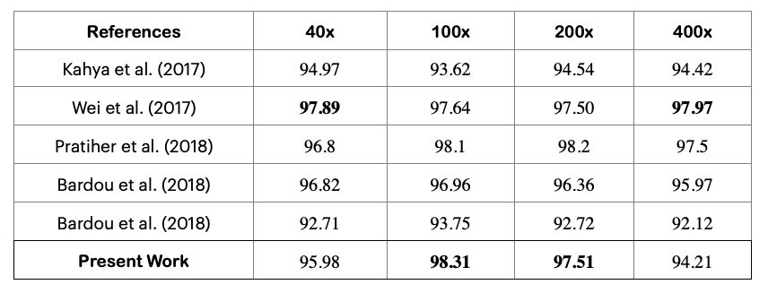
COMPARISON FROM OTHER MODELS
On breakhis dataset

Slide 13
Conclusions
The used model achieved an average accuracy of 96.5% on the breakhis dataset, 91.52% on the ICIAR2018 dataset and 96.74% on Kaggle BHI dataset
The used model has performed good as comparable to the existing models.
The parallel model has proved to be more efficient in terms of the accuracy as it combines all the extracted features from 5 different models and then uses all those features to classify the images.
It is better than using a single CNN network as any single model misses some features.

Slide 14
References
Histopathological Breast Cancer Image Classification by Deep Neural Network Techniques Guided by Local Clustering, 2018.
Breast cancer histopathological image classification using convolutional neural networks, 2016.
Breast cancer classification using digital biopsy histopathology images through transfer learning., 2019.
Breast Cancer Multi-classification through Deep Neural Network and Hierarchical Classification Approach, 2020.
Deep learning-based breast cancer classification through medical imaging modalities: state of the art and research challenges, 2020.
Breast Tumor Classification Using an Ensemble Machine Learning Method, 2020.
Prediction of benign and malignant breast cancer using data mining techniques, 2018.
Histopathological Classification of Breast Cancer Images Using a Multi-Scale Input and Multi-Feature Network, 2020
Dataset for Breast Cancer Histopathological Image Classification, 2016.
Breast Histopathology Images, 198,738 IDC(-) image patches; 78,786 IDC(+) image patches, 2018.
BACH: Grand challenge on breast cancer histology images, Medical Image Analysis, 2019.
Classification of breast cancer histopathology images based on adaptive sparse support vector machine, 2017
Deep learning model based breast cancer histopathological image classifi- cation, 2017
Manifold Learning & Stacked Sparse Autoencoder for Robust Breast Cancer Classification from Histopathological Images, 2018
Classification of Breast Cancer Based on Histology Images Using Con- volutional Neural Networks, 2018

Slide 15
Thank you

